Slide 1
GRADE 7 ACCELERATED · UNIT 5
Multi-Step Proportional Relationships
Six lessons in teaching order · the next slide jumps to each one
Grade 7 Accelerated · Unit 5 — Multi-Step Proportional Relationships
1

Slide 2
Contents
5.01
Scale Drawings
slide 3
5.02–03
Scale Factor: Perimeter and Area
slide 38
5.04
Real-World Scale Drawings
slide 73
5.06–07
Converting Length Across Systems; Currency
slide 108
5.08–09
Converting Mass, Area and Volume
slide 143
5.10–11
Multi-Step Proportion Problems
slide 178
Grade 7 Accelerated · Unit 5 — Multi-Step Proportional Relationships
2

Slide 3
← Contents
GRADE 7 ACCELERATED · UNIT 5 · LESSON 1
Scale Drawings
MA.7.GR.1.5
I can find the scale factor between two figures, and use a scale to find a real length from a drawing or a drawing length from the real one.
Grade 7 Accelerated · Unit 5 · Lesson 1 — Scale Drawings
1

Slide 4
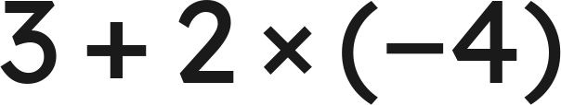
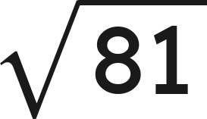

Warm-Up
1. Find the value:
2. Find the value:
3. Write
as a number.
4. On a map, 3 cm stands for 12 km. What does 1 cm stand for?
Grade 7 Accelerated · Unit 5 · Lesson 1 — Scale Drawings
2

Slide 5
Warm-Up
1. Find the value:
−5
2. Find the value:
9
3. Write
as a number.
2,500
4. On a map, 3 cm stands for 12 km. What does 1 cm stand for?
4 km
Grade 7 Accelerated · Unit 5 · Lesson 1 — Scale Drawings
3

Slide 6



Vocabulary
scale drawing
a drawing of a real thing with every length multiplied by the same number: a map, a floor plan, a model
scale factor
the number every length is multiplied by, written
: from 4 cm to 6 cm,
corresponding sides
the side of the copy that matches a side of the original: the 6 cm side matches the 4 cm side
scale
a scale factor with units on it:
means every inch on the map is 20 miles
Grade 7 Accelerated · Unit 5 · Lesson 1 — Scale Drawings
4

Slide 7
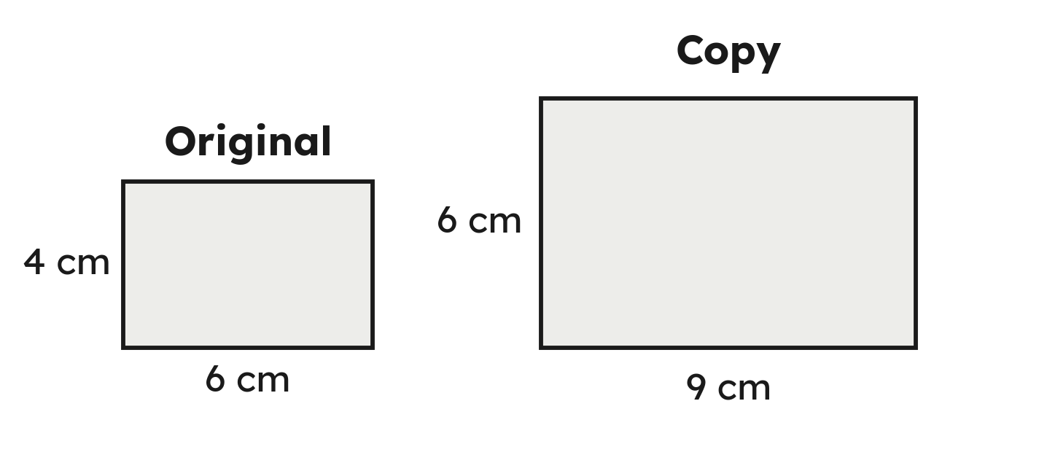
Notes
I. A scale copy: every side times the same number
Every angle is still 90°: k multiplies lengths, not angles.
Grade 7 Accelerated · Unit 5 · Lesson 1 — Scale Drawings
5

Slide 8
Notes
II. Find k: copy divided by original — and k can be less than 1
k = copy ÷ original. Less than 1 shrinks, more than 1 enlarges, 1 is the same size.
Grade 7 Accelerated · Unit 5 · Lesson 1 — Scale Drawings
6

Slide 9
Notes
III. Use k both ways
To the copy, multiply by k. Back to the original, divide by k.
Grade 7 Accelerated · Unit 5 · Lesson 1 — Scale Drawings
7

Slide 10
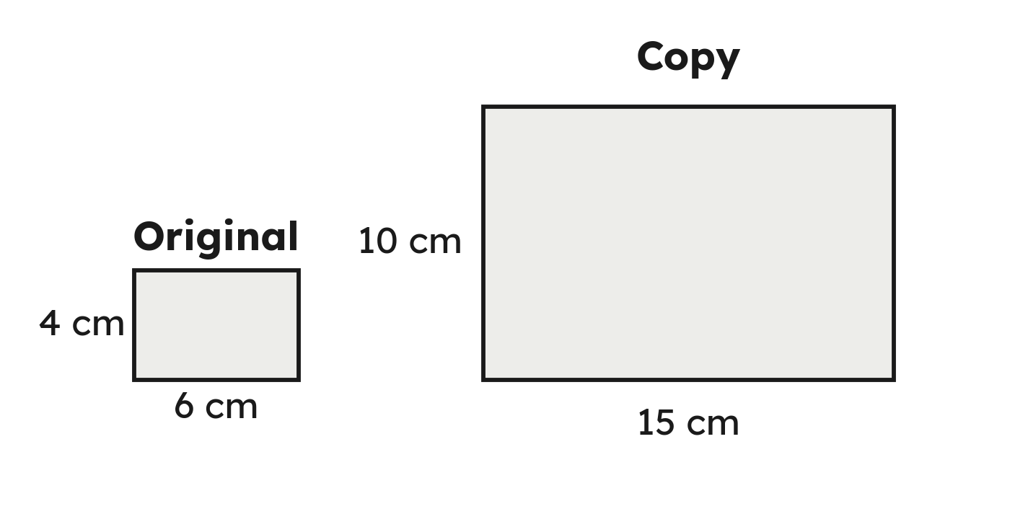
Example 1
A 6 cm by 4 cm rectangle is copied at 15 cm by 10 cm.
Find the scale factor.
Grade 7 Accelerated · Unit 5 · Lesson 1 — Scale Drawings
8

Slide 11
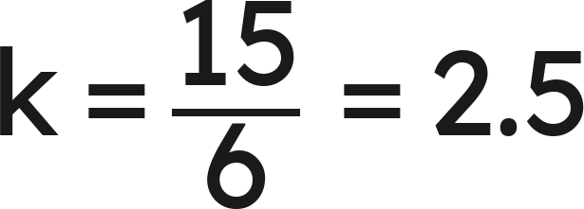
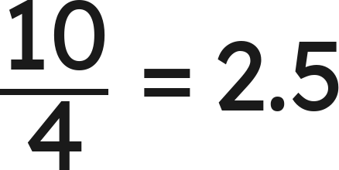
Example 1
Answer: k = 2.5
Grade 7 Accelerated · Unit 5 · Lesson 1 — Scale Drawings
9

Slide 12
Your Turn
An 8 cm by 10 cm rectangle is copied at 12 cm by 15 cm.
Find the scale factor.
Grade 7 Accelerated · Unit 5 · Lesson 1 — Scale Drawings
10

Slide 13
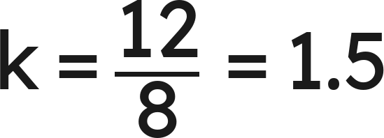
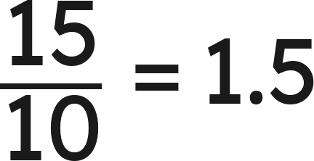
Your Turn
An 8 cm by 10 cm rectangle is copied at 12 cm by 15 cm.
Find the scale factor.
— the same k
Answer: k = 1.5
Grade 7 Accelerated · Unit 5 · Lesson 1 — Scale Drawings
11

Slide 14

Example 2
A map's scale is
.
Two towns are 2.6 in apart on the map.
How far apart are the towns?
Grade 7 Accelerated · Unit 5 · Lesson 1 — Scale Drawings
12

Slide 15

Example 2
Answer: 65 mi
Grade 7 Accelerated · Unit 5 · Lesson 1 — Scale Drawings
13

Slide 16

Your Turn
A map's scale is
.
Two towns are 4.2 cm apart on the map.
How far apart are the towns?
Grade 7 Accelerated · Unit 5 · Lesson 1 — Scale Drawings
14

Slide 17


Your Turn
A map's scale is
.
Two towns are 4.2 cm apart on the map.
How far apart are the towns?
Answer: 63 km
Grade 7 Accelerated · Unit 5 · Lesson 1 — Scale Drawings
15

Slide 18
Whiteboards · Question 1 of 9
A 2 cm side becomes 6 cm in the copy.
What is the scale factor?
Answer it.
Grade 7 Accelerated · Unit 5 · Lesson 1 — Scale Drawings
16

Slide 19
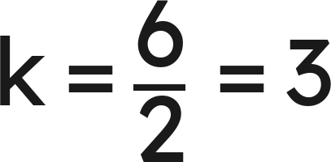
Whiteboards · Question 1 of 9
A 2 cm side becomes 6 cm in the copy.
What is the scale factor?
Answer: k = 3
Grade 7 Accelerated · Unit 5 · Lesson 1 — Scale Drawings
17

Slide 20
Whiteboards · Question 2 of 9
An 8 cm side becomes 4 cm in the copy.
What is the scale factor?
Answer it.
Grade 7 Accelerated · Unit 5 · Lesson 1 — Scale Drawings
18

Slide 21
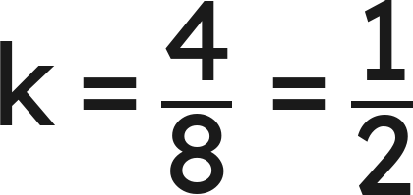
Whiteboards · Question 2 of 9
An 8 cm side becomes 4 cm in the copy.
What is the scale factor?
Answer: k = ½
Grade 7 Accelerated · Unit 5 · Lesson 1 — Scale Drawings
19

Slide 22
Whiteboards · Question 3 of 9
A 12 cm side becomes 9 cm in the copy.
What is the scale factor?
Answer it.
Grade 7 Accelerated · Unit 5 · Lesson 1 — Scale Drawings
20

Slide 23
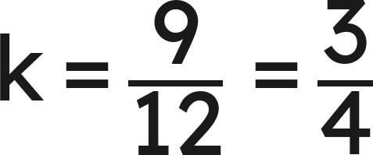
Whiteboards · Question 3 of 9
A 12 cm side becomes 9 cm in the copy.
What is the scale factor?
Answer: k = ¾
Grade 7 Accelerated · Unit 5 · Lesson 1 — Scale Drawings
21

Slide 24




Whiteboards · Question 4 of 9
A side of 5 cm becomes 2 cm in the copy.
What is the scale factor?
A.
B.
C.
D.
Answer it.
Grade 7 Accelerated · Unit 5 · Lesson 1 — Scale Drawings
22

Slide 25
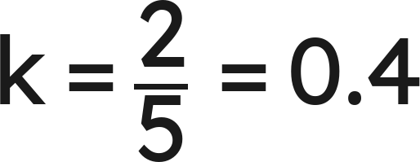
Whiteboards · Question 4 of 9
A side of 5 cm becomes 2 cm in the copy.
What is the scale factor?
Answer: B — 0.4
Grade 7 Accelerated · Unit 5 · Lesson 1 — Scale Drawings
23

Slide 26
Whiteboards · Question 5 of 9
The scale factor is 3.5. A side of the original is 6 cm.
How long is that side in the copy?
Answer it.
Grade 7 Accelerated · Unit 5 · Lesson 1 — Scale Drawings
24

Slide 27

Whiteboards · Question 5 of 9
The scale factor is 3.5. A side of the original is 6 cm.
How long is that side in the copy?
Answer: 21 cm
Grade 7 Accelerated · Unit 5 · Lesson 1 — Scale Drawings
25

Slide 28





Whiteboards · Question 6 of 9
A drawing has a 40° angle. The real figure is a scale copy at
.
What is the angle in the real figure?
A.
B.
C.
D.
Answer it.
Grade 7 Accelerated · Unit 5 · Lesson 1 — Scale Drawings
26

Slide 29


Whiteboards · Question 6 of 9
A drawing has a 40° angle. The real figure is a scale copy at
.
What is the angle in the real figure?
Lengths are multiplied by k. Angles are not.
Answer: A — 40°
Grade 7 Accelerated · Unit 5 · Lesson 1 — Scale Drawings
27

Slide 30
Whiteboards · Question 7 of 9
A triangle has sides 6, 8 and 10. Another has sides 9, 12 and 15; a third has sides 9, 12 and 14.
Which one is a scale copy of the first?
Answer it.
Grade 7 Accelerated · Unit 5 · Lesson 1 — Scale Drawings
28

Slide 31
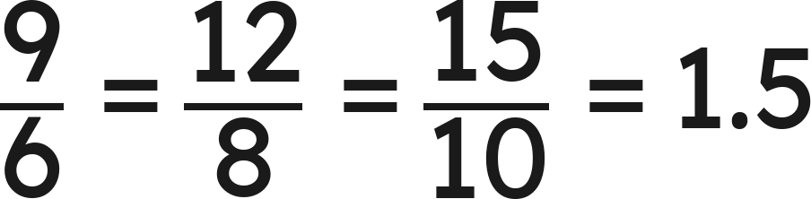
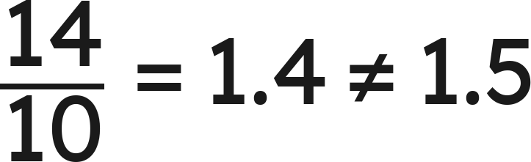
Whiteboards · Question 7 of 9
A triangle has sides 6, 8 and 10. Another has sides 9, 12 and 15; a third has sides 9, 12 and 14.
Which one is a scale copy of the first?
: the second is a copy
: the third is not
Answer: The 9-12-15 triangle (k = 1.5); the 9-12-14 one is not a copy
Grade 7 Accelerated · Unit 5 · Lesson 1 — Scale Drawings
29

Slide 32
Whiteboards · Question 8 of 9
Dev, who is 13, draws a 15-ft wall as 3 in long.
How long is a 20-ft wall on his drawing?
Answer it.
Grade 7 Accelerated · Unit 5 · Lesson 1 — Scale Drawings
30

Slide 33


Whiteboards · Question 8 of 9
Dev, who is 13, draws a 15-ft wall as 3 in long.
How long is a 20-ft wall on his drawing?
: every inch is 5 ft
Answer: 4 in
Grade 7 Accelerated · Unit 5 · Lesson 1 — Scale Drawings
31

Slide 34
Whiteboards · Question 9 of 9
Priya says the scale factor from a 6 cm side to its 3 cm copy is 2.
Is she right? Explain.
Write your answer in sentences.
Grade 7 Accelerated · Unit 5 · Lesson 1 — Scale Drawings
32

Slide 35
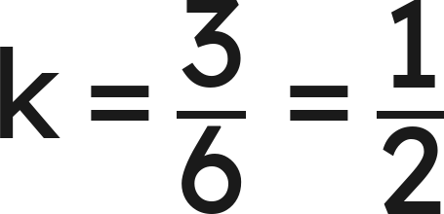
Whiteboards · Question 9 of 9
Priya says the scale factor from a 6 cm side to its 3 cm copy is 2.
Is she right? Explain.
. No: the copy is smaller, so k is under 1.
Answer: No. k = 3 ÷ 6 = ½: the copy is smaller, so k is under 1.
Grade 7 Accelerated · Unit 5 · Lesson 1 — Scale Drawings
33

Slide 36

Independent Set
1.
A 5 cm side becomes 15 cm in the copy. Find the scale factor.
2.
A 15 cm side becomes 6 cm in the copy. Find the scale factor.
3.
A 3 cm by 5 cm rectangle is copied at 7.5 cm by 12.5 cm. Find the scale
factor.
4.
The scale factor is 1.5 and a side of the original is 8 cm. How long is that
side in the copy?
5.
A map's scale is
. Two cities are 2.8 in apart on the map. How far
apart are they?
6.
On the same map, a road is 150 mi long. How long is it on the map?
Grade 7 Accelerated · Unit 5 · Lesson 1 — Scale Drawings
34

Slide 37
IXL
1.
Open IXL and start today's skills.
2.
Work on paper where the question needs work. The answer box does not show it.
3.
Every skill listed is required, to a SmartScore of 67. Due at the start of the next class.
Today's skills — all required
Scale drawings: find the scale factor, missing side, or missing angle — WEA
Grade 7 Accelerated · Unit 5 · Lesson 1 — Scale Drawings
35

Slide 38
← Contents
GRADE 7 ACCELERATED · UNIT 5 · LESSONS 2–3
Scale Factor: Perimeter and Area
MA.7.GR.1.5
I can find the perimeter and the area of a scale copy from the original and k, and find k from two areas.
Grade 7 Accelerated · Unit 5 · Lessons 2–3 — Scale Factor: Perimeter and Area
1

Slide 39
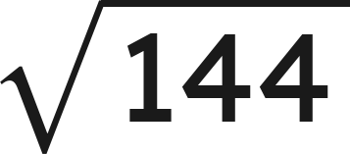


Warm-Up
1. A 20 cm side becomes 8 cm in the copy. Find the scale factor.
2. Find the value:
3. Find the values:
and
4. Find the perimeter and the area of a 3 cm by 5 cm rectangle.
Grade 7 Accelerated · Unit 5 · Lessons 2–3 — Scale Factor: Perimeter and Area
2

Slide 40
Warm-Up
1. A 20 cm side becomes 8 cm in the copy. Find the scale factor.
k = 0.4
2. Find the value:
12
3. Find the values:
and
9 and 27
4. Find the perimeter and the area of a 3 cm by 5 cm rectangle.
P = 16 cm, A = 15 cm²
Grade 7 Accelerated · Unit 5 · Lessons 2–3 — Scale Factor: Perimeter and Area
3

Slide 41

Vocabulary
k squared
, k times k: what an area is multiplied by when every length is multiplied
by
perimeter ratio
copy's perimeter ÷ original's perimeter — it equals
area ratio
copy's area ÷ original's area — it equals
Grade 7 Accelerated · Unit 5 · Lessons 2–3 — Scale Factor: Perimeter and Area
4

Slide 42
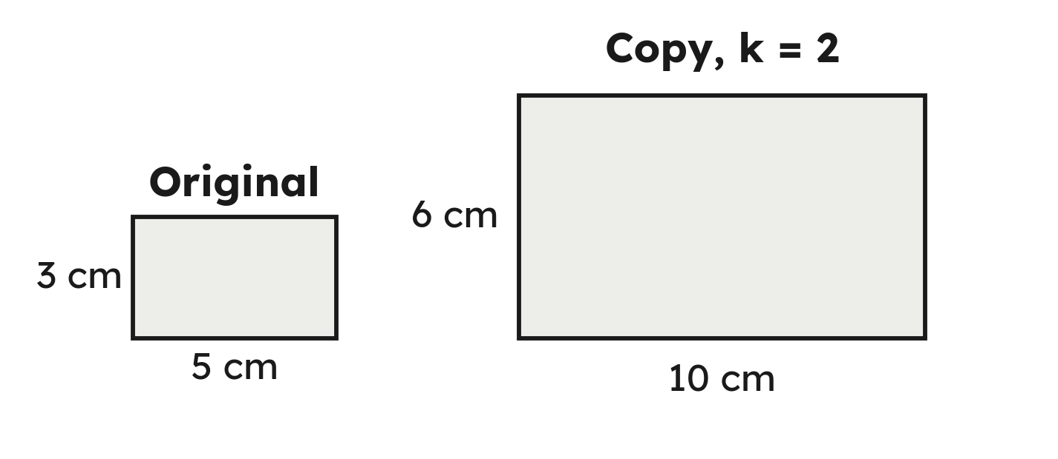
Notes
I. Every side × k, so the perimeter × k
Grade 7 Accelerated · Unit 5 · Lessons 2–3 — Scale Factor: Perimeter and Area
5

Slide 43
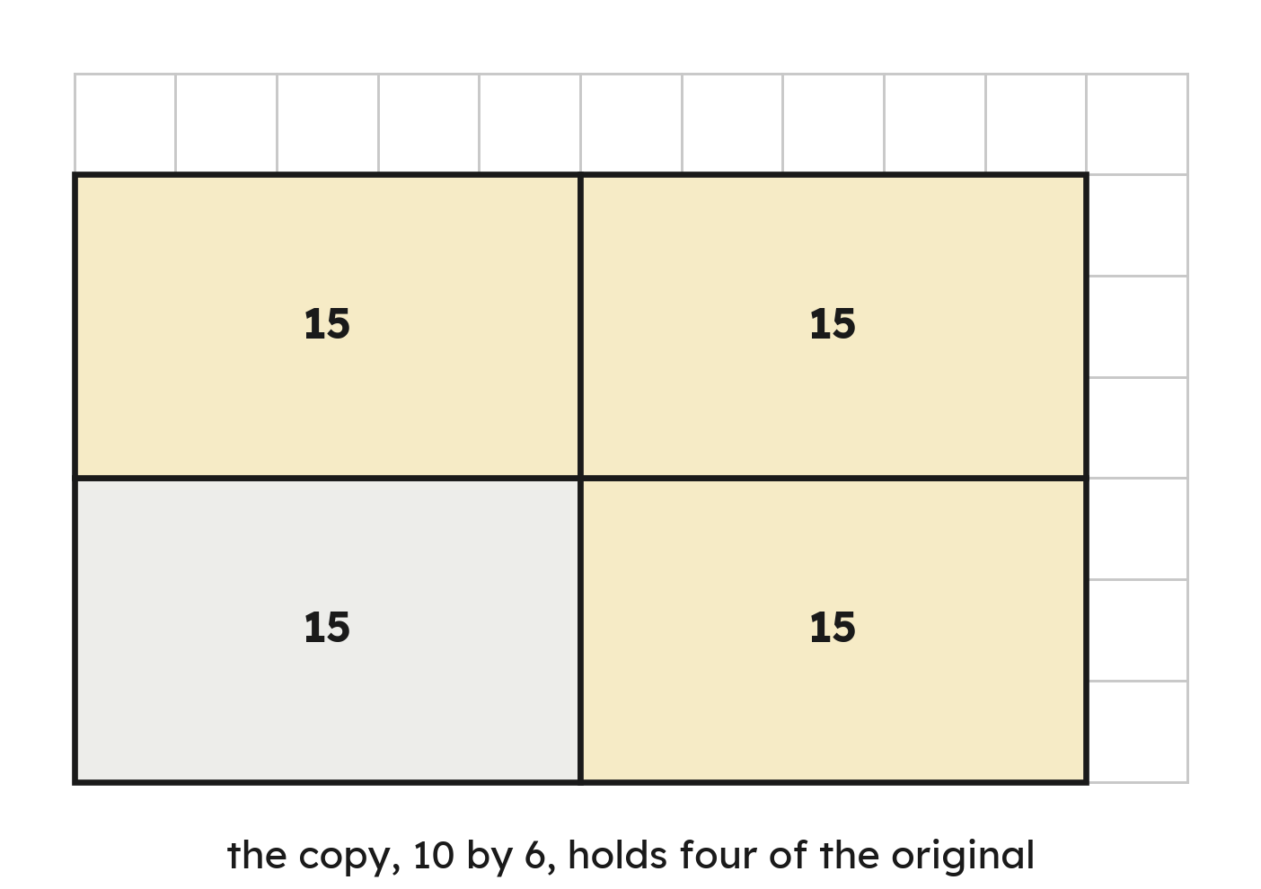
Notes
II. Area is two lengths, so the area × k × k
Grade 7 Accelerated · Unit 5 · Lessons 2–3 — Scale Factor: Perimeter and Area
6

Slide 44
Notes
III. From two areas back to k: a square root
Area ratio = k². k = the square root of the area ratio.
Grade 7 Accelerated · Unit 5 · Lessons 2–3 — Scale Factor: Perimeter and Area
7

Slide 45

Example 1
A 2 cm by 4 cm rectangle is scaled by
.
Find the copy's perimeter and area.
Grade 7 Accelerated · Unit 5 · Lessons 2–3 — Scale Factor: Perimeter and Area
8

Slide 46
Example 1
Answer: P = 36 cm, A = 72 cm²
Grade 7 Accelerated · Unit 5 · Lessons 2–3 — Scale Factor: Perimeter and Area
9

Slide 47

Your Turn
A 3 cm by 6 cm rectangle is scaled by
.
Find the copy's perimeter and area.
Grade 7 Accelerated · Unit 5 · Lessons 2–3 — Scale Factor: Perimeter and Area
10

Slide 48


Your Turn
A 3 cm by 6 cm rectangle is scaled by
.
Find the copy's perimeter and area.
Answer: P = 72 cm, A = 288 cm²
Grade 7 Accelerated · Unit 5 · Lessons 2–3 — Scale Factor: Perimeter and Area
11

Slide 49


Example 2
A figure has area
.
Its scale copy has area
.
A side of the original is 3 cm.
Find k, then the matching side of the copy.
Grade 7 Accelerated · Unit 5 · Lessons 2–3 — Scale Factor: Perimeter and Area
12

Slide 50
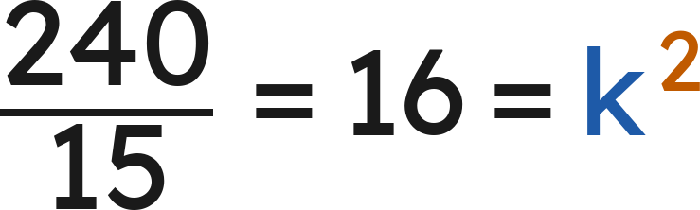
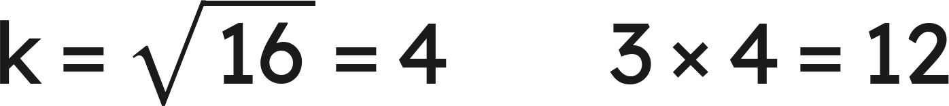
Example 2
Answer: k = 4; the side is 12 cm
Grade 7 Accelerated · Unit 5 · Lessons 2–3 — Scale Factor: Perimeter and Area
13

Slide 51


Your Turn
A figure has area
.
Its scale copy has area
.
A side of the original is 2 cm.
Find
, then the matching side of the copy.
Grade 7 Accelerated · Unit 5 · Lessons 2–3 — Scale Factor: Perimeter and Area
14

Slide 52


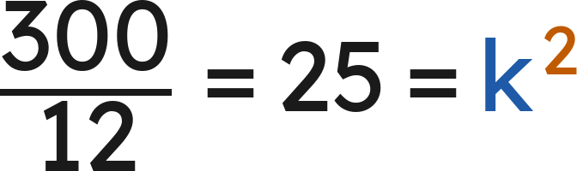
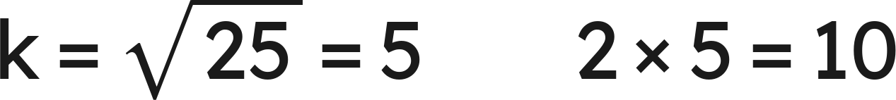
Your Turn
A figure has area
.
Its scale copy has area
.
A side of the original is 2 cm.
Find
, then the matching side of the copy.
Answer: k = 5; the side is 10 cm
Grade 7 Accelerated · Unit 5 · Lessons 2–3 — Scale Factor: Perimeter and Area
15

Slide 53

Whiteboards · Question 1 of 9
A figure with perimeter 14 cm is scaled by
.
What is the copy's perimeter?
Answer it.
Grade 7 Accelerated · Unit 5 · Lessons 2–3 — Scale Factor: Perimeter and Area
16

Slide 54


Whiteboards · Question 1 of 9
A figure with perimeter 14 cm is scaled by
.
What is the copy's perimeter?
Answer: 28 cm
Grade 7 Accelerated · Unit 5 · Lessons 2–3 — Scale Factor: Perimeter and Area
17

Slide 55
Whiteboards · Question 2 of 9
A figure with area
is scaled by
.
What is the copy's area?
Answer it.
Grade 7 Accelerated · Unit 5 · Lessons 2–3 — Scale Factor: Perimeter and Area
18

Slide 56

Whiteboards · Question 2 of 9
A figure with area
is scaled by
.
What is the copy's area?
Answer: 48 cm²
Grade 7 Accelerated · Unit 5 · Lessons 2–3 — Scale Factor: Perimeter and Area
19

Slide 57

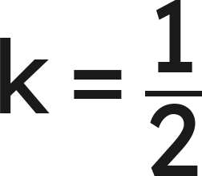
Whiteboards · Question 3 of 9
A figure with area
is scaled by
.
What is the copy's area?
Answer it.
Grade 7 Accelerated · Unit 5 · Lessons 2–3 — Scale Factor: Perimeter and Area
20

Slide 58

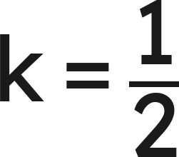
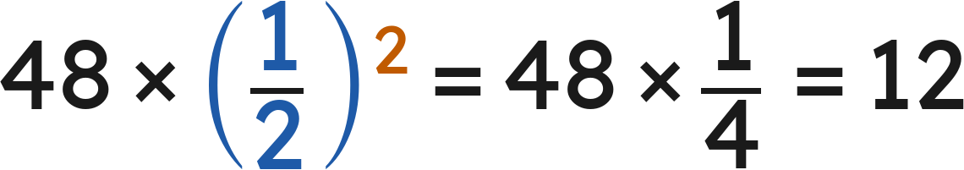
Whiteboards · Question 3 of 9
A figure with area
is scaled by
.
What is the copy's area?
Answer: 12 cm²
Grade 7 Accelerated · Unit 5 · Lessons 2–3 — Scale Factor: Perimeter and Area
21

Slide 59





Whiteboards · Question 4 of 9
A figure with area
is scaled by
.
What is the copy's area?
A.
B.
C.
D.
Answer it.
Grade 7 Accelerated · Unit 5 · Lessons 2–3 — Scale Factor: Perimeter and Area
22

Slide 60



Whiteboards · Question 4 of 9
A figure with area
is scaled by
.
What is the copy's area?
Answer: A — 90 cm²
Grade 7 Accelerated · Unit 5 · Lessons 2–3 — Scale Factor: Perimeter and Area
23

Slide 61

Whiteboards · Question 5 of 9
A figure with area
is scaled by
.
What is the copy's area?
Answer it.
Grade 7 Accelerated · Unit 5 · Lessons 2–3 — Scale Factor: Perimeter and Area
24

Slide 62




Whiteboards · Question 5 of 9
A figure with area
is scaled by
.
What is the copy's area?
Answer: 18 cm²
Grade 7 Accelerated · Unit 5 · Lessons 2–3 — Scale Factor: Perimeter and Area
25

Slide 63



Whiteboards · Question 6 of 9
A figure's perimeter is 20 cm; its copy's perimeter is 60 cm.
What is the area ratio, copy to original?
A.
B.
C.
D.
Answer it.
Grade 7 Accelerated · Unit 5 · Lessons 2–3 — Scale Factor: Perimeter and Area
26

Slide 64
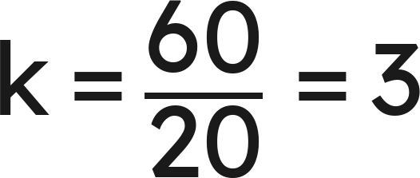

Whiteboards · Question 6 of 9
A figure's perimeter is 20 cm; its copy's perimeter is 60 cm.
What is the area ratio, copy to original?
: the perimeter ratio is k
: the area ratio
Answer: D — 9
Grade 7 Accelerated · Unit 5 · Lessons 2–3 — Scale Factor: Perimeter and Area
27

Slide 65

Whiteboards · Question 7 of 9
A triangle with sides 6, 8 and 10 cm is scaled by
.
Its area is
.
Find the copy's perimeter and area.
Answer it.
Grade 7 Accelerated · Unit 5 · Lessons 2–3 — Scale Factor: Perimeter and Area
28

Slide 66

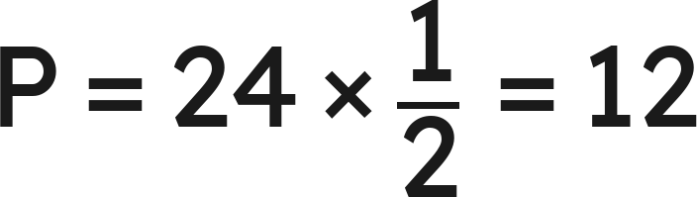
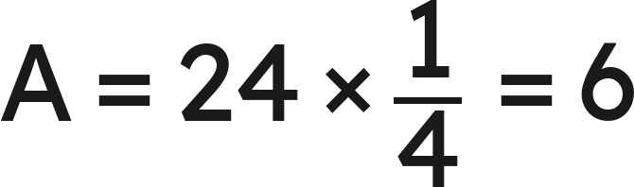
Whiteboards · Question 7 of 9
A triangle with sides 6, 8 and 10 cm is scaled by
.
Its area is
.
Find the copy's perimeter and area.
Answer: P = 12 cm, A = 6 cm²
Grade 7 Accelerated · Unit 5 · Lessons 2–3 — Scale Factor: Perimeter and Area
29

Slide 67
Whiteboards · Question 8 of 9
A 4 in by 6 in photo, taken 3 years ago, is enlarged at
.
What is the enlargement's area?
Answer it.
Grade 7 Accelerated · Unit 5 · Lessons 2–3 — Scale Factor: Perimeter and Area
30

Slide 68

Whiteboards · Question 8 of 9
A 4 in by 6 in photo, taken 3 years ago, is enlarged at
.
What is the enlargement's area?
Answer: 150 in²
Grade 7 Accelerated · Unit 5 · Lessons 2–3 — Scale Factor: Perimeter and Area
31

Slide 69
Whiteboards · Question 9 of 9
Jo says that doubling every side of a rectangle doubles its area.
Explain why not, with a counterexample.
Write your answer in sentences.
Grade 7 Accelerated · Unit 5 · Lessons 2–3 — Scale Factor: Perimeter and Area
32

Slide 70
Whiteboards · Question 9 of 9
Jo says that doubling every side of a rectangle doubles its area.
Explain why not, with a counterexample.
Answer: No: 2 by 7 doubled is 4 by 14, area 14 → 56 — × 4, as both lengths doubled.
Grade 7 Accelerated · Unit 5 · Lessons 2–3 — Scale Factor: Perimeter and Area
33

Slide 71



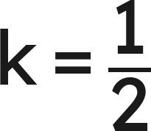




Independent Set
1.
A figure with perimeter 18 cm is scaled by
. Find the copy's perimeter.
2.
A figure with area
is scaled by
. Find the copy's area.
3.
A figure with area
is scaled by
. Find the copy's area.
4.
A 2 cm by 5 cm rectangle is scaled by
. Find the copy's perimeter
and area.
5.
A figure has area
and its scale copy has area
. Find
.
6.
A figure's perimeter is 12 cm and its copy's perimeter is 48 cm. What is the
area ratio, copy to original?
Grade 7 Accelerated · Unit 5 · Lessons 2–3 — Scale Factor: Perimeter and Area
34

Slide 72
IXL
1.
Open IXL and start today's skills.
2.
Work on paper where the question needs work. The answer box does not show it.
3.
Every skill listed is required, to a SmartScore of 67. Due at the start of the next class.
Today's skills — all required
Perimeter and area: changes in scale — ZC6
Scale drawings: find the scale factor or missing side — XHM
Grade 7 Accelerated · Unit 5 · Lessons 2–3 — Scale Factor: Perimeter and Area
35

Slide 73
← Contents
GRADE 7 ACCELERATED · UNIT 5 · LESSON 4
Real-World Scale Drawings
MA.7.GR.1.5
I can use a scale such as ¼ in : 1 ft to find real lengths and areas from a drawing, and drawing lengths from real ones.
Grade 7 Accelerated · Unit 5 · Lesson 4 — Real-World Scale Drawings
1

Slide 74


Warm-Up
1. A figure of area
is scaled by
. The copy's area?
2. A 5 cm side becomes 3 cm in the copy. Find the scale factor.
3. Find the product:
4. A car goes 90 miles in 2 hours. How far does it go per hour?
Grade 7 Accelerated · Unit 5 · Lesson 4 — Real-World Scale Drawings
2

Slide 75
Warm-Up
1. A figure of area
is scaled by
. The copy's area?
36 cm²
2. A 5 cm side becomes 3 cm in the copy. Find the scale factor.
k = 0.6
3. Find the product:
3.6
4. A car goes 90 miles in 2 hours. How far does it go per hour?
45 miles per hour
Grade 7 Accelerated · Unit 5 · Lesson 4 — Real-World Scale Drawings
3

Slide 76
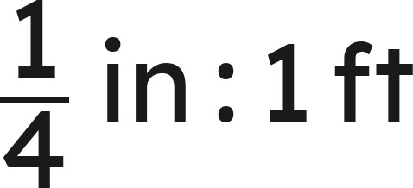



Vocabulary
floor plan
a scale drawing of a room or building seen from above
scale (two units)
a ratio such as
— a drawing length and the real length it stands for
unit rate of a scale
the scale written per 1 drawing unit:
is
scale with one unit
— no units: 1 cm of model is 50 cm of car.
is
this way,
and 48 is the scale factor
Grade 7 Accelerated · Unit 5 · Lesson 4 — Real-World Scale Drawings
4

Slide 77
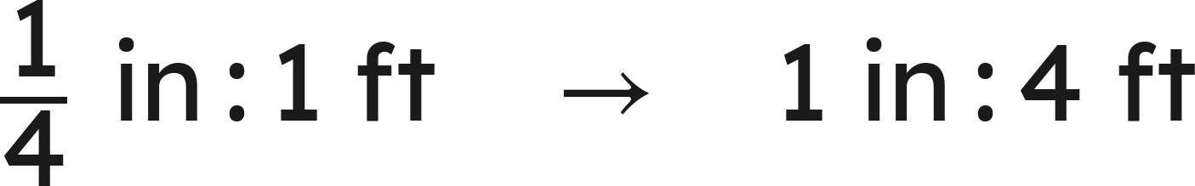
Notes
I. A scale is a rate: write it per 1 unit
Drawing × rate = real. Real ÷ rate = drawing. With one unit, 1 in : 4 ft is 1 : 48.
Grade 7 Accelerated · Unit 5 · Lesson 4 — Real-World Scale Drawings
5

Slide 78
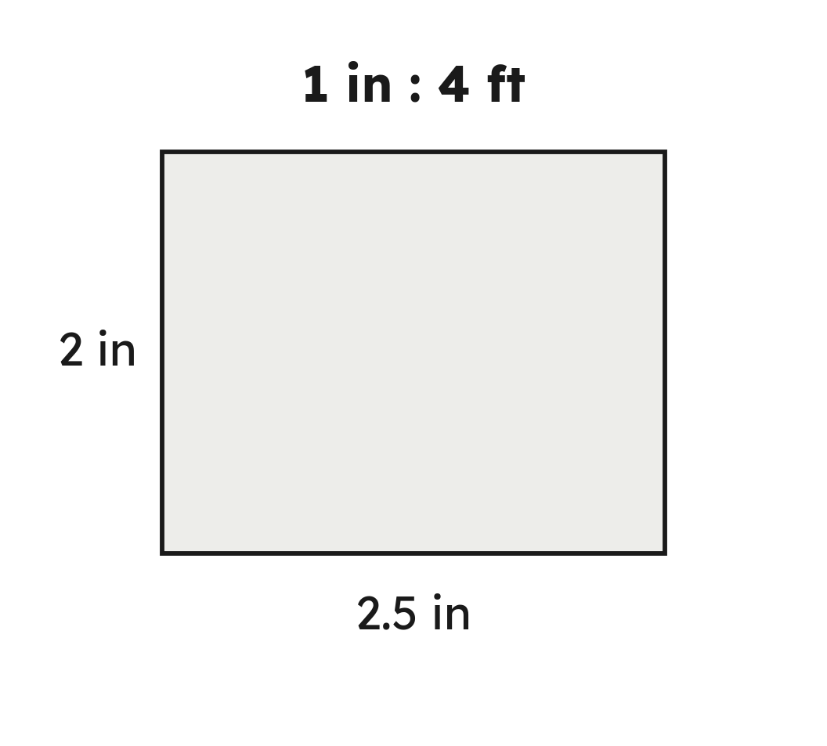

Notes
II. Area: go to the real dimensions first
Grade 7 Accelerated · Unit 5 · Lesson 4 — Real-World Scale Drawings
6

Slide 79

Notes
III. Real to drawing is a division
No scale printed? One pair gives it: 2 in ↔ 9 ft is 4.5 ft per inch.
Grade 7 Accelerated · Unit 5 · Lesson 4 — Real-World Scale Drawings
7

Slide 80
Example 1
A floor plan is drawn at
.
A room is 2.5 in by 3 in on the plan.
Find the room's real dimensions and area.
Grade 7 Accelerated · Unit 5 · Lesson 4 — Real-World Scale Drawings
8

Slide 81
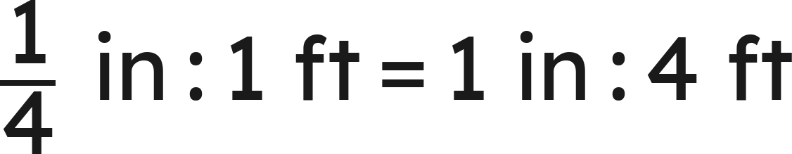

Example 1
Answer: 10 ft by 12 ft; 120 ft²
Grade 7 Accelerated · Unit 5 · Lesson 4 — Real-World Scale Drawings
9

Slide 82
Your Turn
A floor plan is drawn at
.
A room is 1.5 in by 4 in on the plan.
Find the room's real dimensions and area.
Grade 7 Accelerated · Unit 5 · Lesson 4 — Real-World Scale Drawings
10

Slide 83


Your Turn
A floor plan is drawn at
.
A room is 1.5 in by 4 in on the plan.
Find the room's real dimensions and area.
Answer: 6 ft by 16 ft; 96 ft²
Grade 7 Accelerated · Unit 5 · Lesson 4 — Real-World Scale Drawings
11

Slide 84
Example 2
On a drawing a wall is 4 in long; the real wall is 18 ft. Another wall is 6 in long on the drawing.
How long is the second wall really?
Grade 7 Accelerated · Unit 5 · Lesson 4 — Real-World Scale Drawings
12

Slide 85


Example 2
Answer: 27 ft
Grade 7 Accelerated · Unit 5 · Lesson 4 — Real-World Scale Drawings
13

Slide 86
Your Turn
On a drawing a wall is 2 in long; the real wall is 13 ft. Another wall is 5 in long on the drawing.
How long is the second wall really?
Grade 7 Accelerated · Unit 5 · Lesson 4 — Real-World Scale Drawings
14

Slide 87


Your Turn
On a drawing a wall is 2 in long; the real wall is 13 ft. Another wall is 5 in long on the drawing.
How long is the second wall really?
ft per in
Answer: 32.5 ft
Grade 7 Accelerated · Unit 5 · Lesson 4 — Real-World Scale Drawings
15

Slide 88
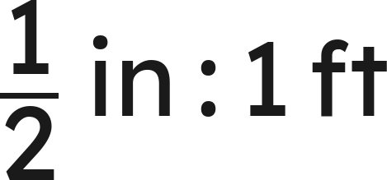
Whiteboards · Question 1 of 9
A plan is drawn at
.
A wall is 4 in long on it.
How long is the real wall?
Answer it.
Grade 7 Accelerated · Unit 5 · Lesson 4 — Real-World Scale Drawings
16

Slide 89

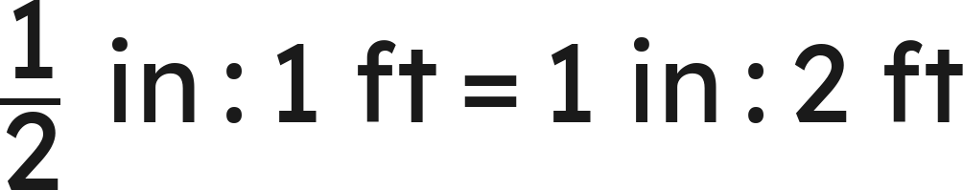

Whiteboards · Question 1 of 9
A plan is drawn at
.
A wall is 4 in long on it.
How long is the real wall?
Answer: 8 ft
Grade 7 Accelerated · Unit 5 · Lesson 4 — Real-World Scale Drawings
17

Slide 90

Whiteboards · Question 2 of 9
A plan is drawn at
.
A room is 2.5 in long on it.
How long is the real room?
Answer it.
Grade 7 Accelerated · Unit 5 · Lesson 4 — Real-World Scale Drawings
18

Slide 91


Whiteboards · Question 2 of 9
A plan is drawn at
.
A room is 2.5 in long on it.
How long is the real room?
Answer: 7.5 ft
Grade 7 Accelerated · Unit 5 · Lesson 4 — Real-World Scale Drawings
19

Slide 92
Whiteboards · Question 3 of 9
A plan is drawn at
.
A real wall is 21 ft long.
How long is it on the plan?
Answer it.
Grade 7 Accelerated · Unit 5 · Lesson 4 — Real-World Scale Drawings
20

Slide 93

Whiteboards · Question 3 of 9
A plan is drawn at
.
A real wall is 21 ft long.
How long is it on the plan?
Answer: 7 in
Grade 7 Accelerated · Unit 5 · Lesson 4 — Real-World Scale Drawings
21

Slide 94




Whiteboards · Question 4 of 9
A model car is built at
and is 8 cm long.
How long is the real car?
A.
B.
C.
D.
Answer it.
Grade 7 Accelerated · Unit 5 · Lesson 4 — Real-World Scale Drawings
22

Slide 95



Whiteboards · Question 4 of 9
A model car is built at
and is 8 cm long.
How long is the real car?
cm
m
Answer: A — 4 m
Grade 7 Accelerated · Unit 5 · Lesson 4 — Real-World Scale Drawings
23

Slide 96
Whiteboards · Question 5 of 9
A plan is drawn at
.
A real wall is 15 ft long.
How long is it on the plan?
Answer it.
Grade 7 Accelerated · Unit 5 · Lesson 4 — Real-World Scale Drawings
24

Slide 97
Whiteboards · Question 5 of 9
A plan is drawn at
.
A real wall is 15 ft long.
How long is it on the plan?
Answer: 3.75 in
Grade 7 Accelerated · Unit 5 · Lesson 4 — Real-World Scale Drawings
25

Slide 98
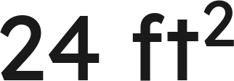



Whiteboards · Question 6 of 9
A plan is drawn at
.
A room is 2 in by 3 in on it.
What is the room's real area?
A.
B.
C.
D.
Answer it.
Grade 7 Accelerated · Unit 5 · Lesson 4 — Real-World Scale Drawings
26

Slide 99


Whiteboards · Question 6 of 9
A plan is drawn at
.
A room is 2 in by 3 in on it.
What is the room's real area?
Answer: B — 96 ft²
Grade 7 Accelerated · Unit 5 · Lesson 4 — Real-World Scale Drawings
27

Slide 100

Whiteboards · Question 7 of 9
A plane is 36 ft long.
One model of it is built at
, another at
.
Which model is longer, and by how much?
Answer it.
Grade 7 Accelerated · Unit 5 · Lesson 4 — Real-World Scale Drawings
28

Slide 101


Whiteboards · Question 7 of 9
A plane is 36 ft long.
One model of it is built at
, another at
.
Which model is longer, and by how much?
in
Answer: The 1 : 48 model, by 3 in (9 in against 6 in)
Grade 7 Accelerated · Unit 5 · Lesson 4 — Real-World Scale Drawings
29

Slide 102

Whiteboards · Question 8 of 9
Mia, who is 13, enlarges her 9 in by 12 in poster into a mural.
The mural's scale is
.
What are the mural's dimensions?
Answer it.
Grade 7 Accelerated · Unit 5 · Lesson 4 — Real-World Scale Drawings
30

Slide 103

Whiteboards · Question 8 of 9
Mia, who is 13, enlarges her 9 in by 12 in poster into a mural.
The mural's scale is
.
What are the mural's dimensions?
Answer: 18 ft by 24 ft
Grade 7 Accelerated · Unit 5 · Lesson 4 — Real-World Scale Drawings
31

Slide 104
Whiteboards · Question 9 of 9
On Andrew's drawing a wall is 3.5 in wide and 4 in tall; the real wall is 26.25 ft wide.
Find the real height and the real area. Which step uses the scale?
Write your answer in sentences.
Grade 7 Accelerated · Unit 5 · Lesson 4 — Real-World Scale Drawings
32

Slide 105
Whiteboards · Question 9 of 9
On Andrew's drawing a wall is 3.5 in wide and 4 in tall; the real wall is 26.25 ft wide.
Find the real height and the real area. Which step uses the scale?
Answer: 30 ft high; 787.5 ft². The scale (7.5 ft per in) is the step from 4 in to 30 ft.
Grade 7 Accelerated · Unit 5 · Lesson 4 — Real-World Scale Drawings
33

Slide 106


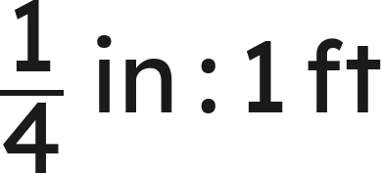

Independent Set
1.
A plan is drawn at
. A wall is 6 in long on it. Find the real length.
2.
A plan is drawn at
. A room is 3.2 in long on it. Find the real length.
3.
A plan is drawn at
. A real wall is 22 ft long. Find its length on the plan.
4.
A plan is drawn at
. A room is 2 in by 3.5 in on it. Find the real dimensions
and area.
5.
A model boat is built at
and is 15 cm long. Find the real boat's length in
meters.
6.
On a drawing a wall is 3 in long; the real wall is 16.5 ft. Another wall is 5 in long on
the drawing. How long is it really?
Grade 7 Accelerated · Unit 5 · Lesson 4 — Real-World Scale Drawings
34

Slide 107
IXL
1.
Open IXL and start today's skills.
2.
Work on paper where the question needs work. The answer box does not show it.
3.
Every skill listed is required, to a SmartScore of 67. Due at the start of the next class.
Today's skills — all required
Scale drawings: word problems — 84H
Scale drawings: scale factor word problems — KCM
Grade 7 Accelerated · Unit 5 · Lesson 4 — Real-World Scale Drawings
35

Slide 108
← Contents
GRADE 7 ACCELERATED · UNIT 5 · LESSONS 6–7
Converting Length Across Systems; Currency
MA.7.AR.3.3
I can convert a length between the customary and metric systems with a ratio from the reference sheet, and convert money with a given rate.
Grade 7 Accelerated · Unit 5 · Lessons 6–7 — Converting Length Across Systems; Currency
1

Slide 109


Warm-Up
1. At
, how long is a 10-ft wall on the plan?
2. A 14 cm side becomes 7 cm in the copy. Find the scale factor.
3. Find the quotient:
4.
. How many feet is 30 in?
Grade 7 Accelerated · Unit 5 · Lessons 6–7 — Converting Length Across Systems; Currency
2

Slide 110
Warm-Up
1. At
, how long is a 10-ft wall on the plan?
2.5 in
2. A 14 cm side becomes 7 cm in the copy. Find the scale factor.
k = ½
3. Find the quotient:
5
4.
. How many feet is 30 in?
2.5 ft
Grade 7 Accelerated · Unit 5 · Lessons 6–7 — Converting Length Across Systems; Currency
3

Slide 111

Vocabulary
customary
the inch–foot–mile–pound–gallon system
metric
the centimeter–meter–kilometer–kilogram–liter system
conversion ratio
a pair of equal measures, such as
, written as a fraction that equals 1
exchange rate
how much of one currency one unit of another buys — a rate someone sets, printed on the problem
Grade 7 Accelerated · Unit 5 · Lessons 6–7 — Converting Length Across Systems; Currency
4

Slide 112
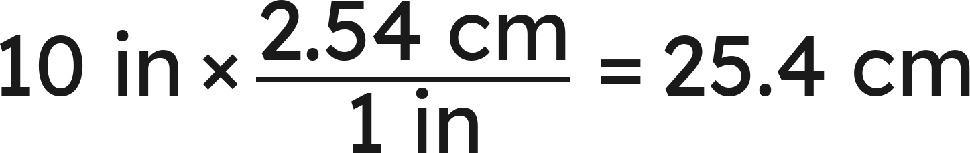
Notes
I. A conversion ratio is a form of 1
Grade 7 Accelerated · Unit 5 · Lessons 6–7 — Converting Length Across Systems; Currency
5

Slide 113
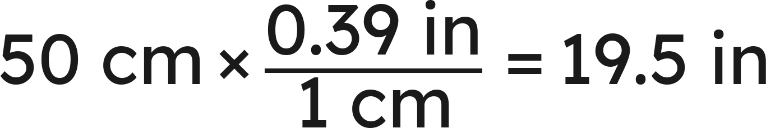
Notes
II. Which ratio? Estimate first
Pick the ratio whose 1 is the unit you have. Estimate: which is the bigger unit?
Grade 7 Accelerated · Unit 5 · Lessons 6–7 — Converting Length Across Systems; Currency
6

Slide 114
Notes
III. Money is a rate someone sets
Grade 7 Accelerated · Unit 5 · Lessons 6–7 — Converting Length Across Systems; Currency
7

Slide 115
Example 1
. A tablet screen is 15 in across.
How many centimeters is that?
Grade 7 Accelerated · Unit 5 · Lessons 6–7 — Converting Length Across Systems; Currency
8

Slide 116

Example 1
Answer: 38.1 cm
Grade 7 Accelerated · Unit 5 · Lessons 6–7 — Converting Length Across Systems; Currency
9

Slide 117
Your Turn
. A monitor is 25 in across.
How many centimeters is that?
Grade 7 Accelerated · Unit 5 · Lessons 6–7 — Converting Length Across Systems; Currency
10

Slide 118


Your Turn
. A monitor is 25 in across.
How many centimeters is that?
Answer: 63.5 cm
Grade 7 Accelerated · Unit 5 · Lessons 6–7 — Converting Length Across Systems; Currency
11

Slide 119
Example 2
Today's rate:
.
How many euros is $80? And how many dollars is 46 euros?
Grade 7 Accelerated · Unit 5 · Lessons 6–7 — Converting Length Across Systems; Currency
12

Slide 120

Example 2
Answer: 73.60 euros; $50
Grade 7 Accelerated · Unit 5 · Lessons 6–7 — Converting Length Across Systems; Currency
13

Slide 121
Your Turn
Today's rate:
(CAD).
$120 in CAD? And 81 CAD in US dollars?
Grade 7 Accelerated · Unit 5 · Lessons 6–7 — Converting Length Across Systems; Currency
14

Slide 122


Your Turn
Today's rate:
(CAD).
$120 in CAD? And 81 CAD in US dollars?
Answer: 162 CAD; $60
Grade 7 Accelerated · Unit 5 · Lessons 6–7 — Converting Length Across Systems; Currency
15

Slide 123
Whiteboards · Question 1 of 9
. A ruler is 20 in long.
How many centimeters is that?
Answer it.
Grade 7 Accelerated · Unit 5 · Lessons 6–7 — Converting Length Across Systems; Currency
16

Slide 124

Whiteboards · Question 1 of 9
. A ruler is 20 in long.
How many centimeters is that?
Answer: 50.8 cm
Grade 7 Accelerated · Unit 5 · Lessons 6–7 — Converting Length Across Systems; Currency
17

Slide 125

Whiteboards · Question 2 of 9
. A phone is 20 cm long.
How many inches is that?
Answer it.
Grade 7 Accelerated · Unit 5 · Lessons 6–7 — Converting Length Across Systems; Currency
18

Slide 126

Whiteboards · Question 2 of 9
. A phone is 20 cm long.
How many inches is that?
Answer: 7.8 in
Grade 7 Accelerated · Unit 5 · Lessons 6–7 — Converting Length Across Systems; Currency
19

Slide 127

Whiteboards · Question 3 of 9
. A race is 5 mi long.
How many kilometers is that?
Answer it.
Grade 7 Accelerated · Unit 5 · Lessons 6–7 — Converting Length Across Systems; Currency
20

Slide 128


Whiteboards · Question 3 of 9
. A race is 5 mi long.
How many kilometers is that?
Answer: 8.05 km
Grade 7 Accelerated · Unit 5 · Lessons 6–7 — Converting Length Across Systems; Currency
21

Slide 129





Whiteboards · Question 4 of 9
. A trail is 5 km long.
How many miles is that?
A.
B.
C.
D.
Answer it.
Grade 7 Accelerated · Unit 5 · Lessons 6–7 — Converting Length Across Systems; Currency
22

Slide 130


Whiteboards · Question 4 of 9
. A trail is 5 km long.
How many miles is that?
Answer: D — 3.1 mi
Grade 7 Accelerated · Unit 5 · Lessons 6–7 — Converting Length Across Systems; Currency
23

Slide 131

Whiteboards · Question 5 of 9
and
.
A door is 6 ft tall.
How many centimeters is that?
Answer it.
Grade 7 Accelerated · Unit 5 · Lessons 6–7 — Converting Length Across Systems; Currency
24

Slide 132

Whiteboards · Question 5 of 9
and
.
A door is 6 ft tall.
How many centimeters is that?
Answer: 182.88 cm
Grade 7 Accelerated · Unit 5 · Lessons 6–7 — Converting Length Across Systems; Currency
25

Slide 133



Whiteboards · Question 6 of 9
,
,
.
A table is 3 yd long.
About how many centimeters is that? Estimate, then compute.
Answer it.
Grade 7 Accelerated · Unit 5 · Lessons 6–7 — Converting Length Across Systems; Currency
26

Slide 134



Whiteboards · Question 6 of 9
,
,
.
A table is 3 yd long.
About how many centimeters is that? Estimate, then compute.
Estimate: 3 yd is a bit under 3 m, so about 270 cm
Answer: About 270; exactly 274.32 cm
Grade 7 Accelerated · Unit 5 · Lessons 6–7 — Converting Length Across Systems; Currency
27

Slide 135


Whiteboards · Question 7 of 9
Rate on Nov 2:
;
.
Theo changes $200 to CAD, then to pesos.
How many pesos does he get?
Answer it.
Grade 7 Accelerated · Unit 5 · Lessons 6–7 — Converting Length Across Systems; Currency
28

Slide 136


Whiteboards · Question 7 of 9
Rate on Nov 2:
;
.
Theo changes $200 to CAD, then to pesos.
How many pesos does he get?
Answer: 4,276.80 pesos
Grade 7 Accelerated · Unit 5 · Lessons 6–7 — Converting Length Across Systems; Currency
29

Slide 137

Whiteboards · Question 8 of 9
.
Theo, who weighs 110 lb, rides a 12 km trail.
How long is the trail in miles?
Answer it.
Grade 7 Accelerated · Unit 5 · Lessons 6–7 — Converting Length Across Systems; Currency
30

Slide 138


Whiteboards · Question 8 of 9
.
Theo, who weighs 110 lb, rides a 12 km trail.
How long is the trail in miles?
Answer: 7.44 mi
Grade 7 Accelerated · Unit 5 · Lessons 6–7 — Converting Length Across Systems; Currency
31

Slide 139


Whiteboards · Question 9 of 9
;
.
Jo converts 30 cm to inches:
.
Name the error and fix it.
Write your answer in sentences.
Grade 7 Accelerated · Unit 5 · Lessons 6–7 — Converting Length Across Systems; Currency
32

Slide 140



Whiteboards · Question 9 of 9
;
.
Jo converts 30 cm to inches:
.
Name the error and fix it.
Answer: She used the inches ratio on centimeters. Inches are bigger, so fewer: 11.7 in.
Grade 7 Accelerated · Unit 5 · Lessons 6–7 — Converting Length Across Systems; Currency
33

Slide 141

Independent Set
1.
. How many centimeters is 12 in?
2.
. How many inches is 40 cm?
3.
. How many kilometers is 10 mi?
4.
. How many miles is 8 km?
5.
,
,
. How many centimeters is 2 yd?
Estimate first.
6.
Today's rate:
. How many euros is $50? How
many dollars is 23 euros?
Grade 7 Accelerated · Unit 5 · Lessons 6–7 — Converting Length Across Systems; Currency
34

Slide 142
IXL
1.
Open IXL and start today's skills.
2.
Work on paper where the question needs work. The answer box does not show it.
3.
Every skill listed is required, to a SmartScore of 67. Due at the start of the next class.
Today's skills — all required
Convert between customary and metric systems — E8Z
Compare and convert customary units — 4B8
Compare and convert metric units — HW2
Grade 7 Accelerated · Unit 5 · Lessons 6–7 — Converting Length Across Systems; Currency
35

Slide 143
← Contents
GRADE 7 ACCELERATED · UNIT 5 · LESSONS 8–9
Converting Mass, Area and Volume
MA.7.AR.3.3
I can convert mass, volume and area between systems, and square the length ratio for area.
Grade 7 Accelerated · Unit 5 · Lessons 8–9 — Converting Mass, Area and Volume
1

Slide 144


Warm-Up
1.
. How many centimeters is 12 in?
2. A figure of area
is scaled by
. The copy's area?
3. Find the product:
4.
. A 1-ft square has what area in square inches?
Grade 7 Accelerated · Unit 5 · Lessons 8–9 — Converting Mass, Area and Volume
2

Slide 145
Warm-Up
1.
. How many centimeters is 12 in?
30.48 cm
2. A figure of area
is scaled by
. The copy's area?
63 cm²
3. Find the product:
−10
4.
. A 1-ft square has what area in square inches?
144 in²
Grade 7 Accelerated · Unit 5 · Lessons 8–9 — Converting Mass, Area and Volume
3

Slide 146








Vocabulary
mass and weight
pounds and kilograms — one word on this test
ounce (oz)
a weight:
,
fluid ounce (fl oz)
a volume:
— not the same unit as the ounce
square units
,
,
— an area; the length ratio is used twice
cubic units
,
— a volume; the length ratio is used three times
Grade 7 Accelerated · Unit 5 · Lessons 8–9 — Converting Mass, Area and Volume
4

Slide 147
Notes
I. Mass and volume convert like length
Grade 7 Accelerated · Unit 5 · Lessons 8–9 — Converting Mass, Area and Volume
5

Slide 148
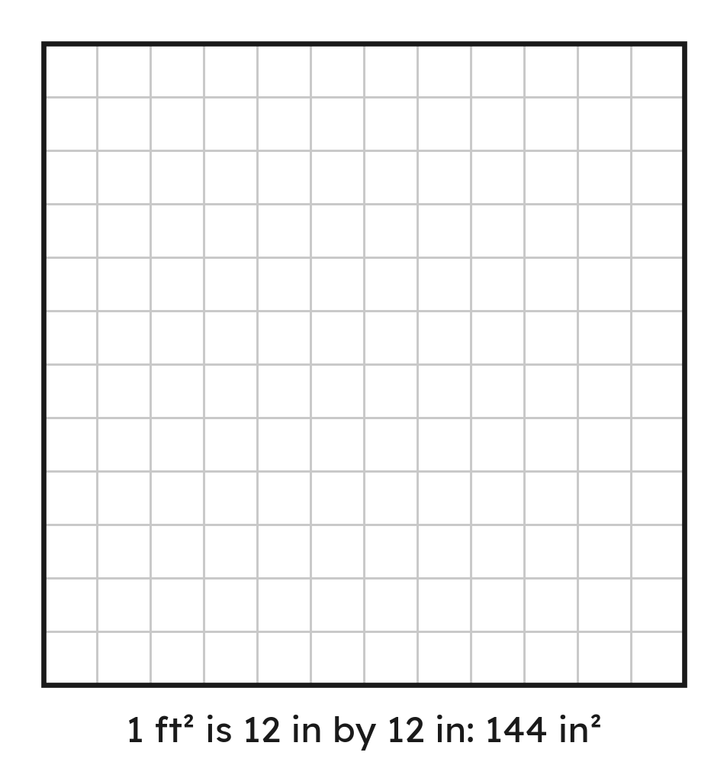
Notes
II. Area: the length ratio is used twice
Grade 7 Accelerated · Unit 5 · Lessons 8–9 — Converting Mass, Area and Volume
6

Slide 149
Notes
III. Fluid ounces go through cups
Length: the ratio once. Area: twice. Volume: three times.
Grade 7 Accelerated · Unit 5 · Lessons 8–9 — Converting Mass, Area and Volume
7

Slide 150

Example 1
. A suitcase weighs 70 lb.
How many kilograms is that?
Grade 7 Accelerated · Unit 5 · Lessons 8–9 — Converting Mass, Area and Volume
8

Slide 151
Example 1
Answer: 31.78 kg
Grade 7 Accelerated · Unit 5 · Lessons 8–9 — Converting Mass, Area and Volume
9

Slide 152
Your Turn
. A crate weighs 90 lb.
How many kilograms is that?
Grade 7 Accelerated · Unit 5 · Lessons 8–9 — Converting Mass, Area and Volume
10

Slide 153

Your Turn
. A crate weighs 90 lb.
How many kilograms is that?
Answer: 40.86 kg (about 40.9)
Grade 7 Accelerated · Unit 5 · Lessons 8–9 — Converting Mass, Area and Volume
11

Slide 154

Example 2
. A tile is
in area.
How many square inches is that?
Grade 7 Accelerated · Unit 5 · Lessons 8–9 — Converting Mass, Area and Volume
12

Slide 155


Example 2
Answer: 720 in²
Grade 7 Accelerated · Unit 5 · Lessons 8–9 — Converting Mass, Area and Volume
13

Slide 156


Your Turn
. A patio is
in area.
How many square feet is that?
Grade 7 Accelerated · Unit 5 · Lessons 8–9 — Converting Mass, Area and Volume
14

Slide 157




Your Turn
. A patio is
in area.
How many square feet is that?
ft² in a square yard
Answer: 45 ft²
Grade 7 Accelerated · Unit 5 · Lessons 8–9 — Converting Mass, Area and Volume
15

Slide 158

Whiteboards · Question 1 of 9
. A bag of rice is 10 kg.
How many pounds is that?
Answer it.
Grade 7 Accelerated · Unit 5 · Lessons 8–9 — Converting Mass, Area and Volume
16

Slide 159

Whiteboards · Question 1 of 9
. A bag of rice is 10 kg.
How many pounds is that?
Answer: 22.04 lb
Grade 7 Accelerated · Unit 5 · Lessons 8–9 — Converting Mass, Area and Volume
17

Slide 160

Whiteboards · Question 2 of 9
. A cooler holds 4 gal.
How many liters is that?
Answer it.
Grade 7 Accelerated · Unit 5 · Lessons 8–9 — Converting Mass, Area and Volume
18

Slide 161


Whiteboards · Question 2 of 9
. A cooler holds 4 gal.
How many liters is that?
Answer: 15.14 L
Grade 7 Accelerated · Unit 5 · Lessons 8–9 — Converting Mass, Area and Volume
19

Slide 162

Whiteboards · Question 3 of 9
. A tank holds 10 L.
How many gallons is that?
Answer it.
Grade 7 Accelerated · Unit 5 · Lessons 8–9 — Converting Mass, Area and Volume
20

Slide 163


Whiteboards · Question 3 of 9
. A tank holds 10 L.
How many gallons is that?
Answer: 2.64 gal
Grade 7 Accelerated · Unit 5 · Lessons 8–9 — Converting Mass, Area and Volume
21

Slide 164

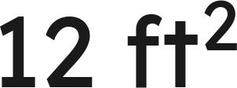
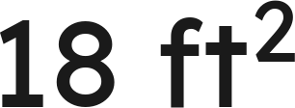
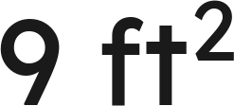
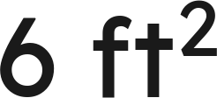
Whiteboards · Question 4 of 9
.
A patch of lawn is
in area.
How many square feet is that?
A.
B.
C.
D.
Answer it.
Grade 7 Accelerated · Unit 5 · Lessons 8–9 — Converting Mass, Area and Volume
22

Slide 165


Whiteboards · Question 4 of 9
.
A patch of lawn is
in area.
How many square feet is that?
ft² in a square yard
Answer: B — 18 ft²
Grade 7 Accelerated · Unit 5 · Lessons 8–9 — Converting Mass, Area and Volume
23

Slide 166

Whiteboards · Question 5 of 9
and
.
A bottle holds 16 fl oz.
How many liters is that?
Answer it.
Grade 7 Accelerated · Unit 5 · Lessons 8–9 — Converting Mass, Area and Volume
24

Slide 167




Whiteboards · Question 5 of 9
and
.
A bottle holds 16 fl oz.
How many liters is that?
Answer: 0.48 L
Grade 7 Accelerated · Unit 5 · Lessons 8–9 — Converting Mass, Area and Volume
25

Slide 168






Whiteboards · Question 6 of 9
.
How many square centimeters is
?
A.
B.
C.
D.
Answer it.
Grade 7 Accelerated · Unit 5 · Lessons 8–9 — Converting Mass, Area and Volume
26

Slide 169



Whiteboards · Question 6 of 9
.
How many square centimeters is
?
Answer: C — 10,000 cm²
Grade 7 Accelerated · Unit 5 · Lessons 8–9 — Converting Mass, Area and Volume
27

Slide 170

Whiteboards · Question 7 of 9
.
A 5-lb bag of flour and a 2.5-kg bag of sugar.
Which is heavier, and by how much?
Answer it.
Grade 7 Accelerated · Unit 5 · Lessons 8–9 — Converting Mass, Area and Volume
28

Slide 171


Whiteboards · Question 7 of 9
.
A 5-lb bag of flour and a 2.5-kg bag of sugar.
Which is heavier, and by how much?
Answer: The sugar, by 0.51 lb
Grade 7 Accelerated · Unit 5 · Lessons 8–9 — Converting Mass, Area and Volume
29

Slide 172

Whiteboards · Question 8 of 9
.
A 20-gal fish tank, bought for $45, is being filled.
How many liters does it hold?
Answer it.
Grade 7 Accelerated · Unit 5 · Lessons 8–9 — Converting Mass, Area and Volume
30

Slide 173


Whiteboards · Question 8 of 9
.
A 20-gal fish tank, bought for $45, is being filled.
How many liters does it hold?
Answer: 75.7 L
Grade 7 Accelerated · Unit 5 · Lessons 8–9 — Converting Mass, Area and Volume
31

Slide 174
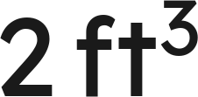


Whiteboards · Question 9 of 9
.
Priya says
is
, because
.
Name the error and fix it.
Write your answer in sentences.
Grade 7 Accelerated · Unit 5 · Lessons 8–9 — Converting Mass, Area and Volume
32

Slide 175



Whiteboards · Question 9 of 9
.
Priya says
is
, because
.
Name the error and fix it.
Answer: She used the ratio once. A cubic foot is 12 × 12 × 12 = 1,728 in³, so 2 ft³ = 3,456 in³.
Grade 7 Accelerated · Unit 5 · Lessons 8–9 — Converting Mass, Area and Volume
33

Slide 176






Independent Set
1.
. How many kilograms is 30 lb?
2.
. How many pounds is 25 kg?
3.
. How many liters is 6 gal?
4.
. How many square inches is
?
5.
and
. How many liters is 24 fl oz?
6.
. How many square meters is
? (Round to two
places.)
Grade 7 Accelerated · Unit 5 · Lessons 8–9 — Converting Mass, Area and Volume
34

Slide 177
IXL
1.
Open IXL and start today's skills.
2.
Work on paper where the question needs work. The answer box does not show it.
3.
Every skill listed is required, to a SmartScore of 67. Due at the start of the next class.
Today's skills — all required
Convert between customary and metric systems — E8Z
Compare and convert customary units — 4B8
Compare and convert metric units — HW2
Grade 7 Accelerated · Unit 5 · Lessons 8–9 — Converting Mass, Area and Volume
35

Slide 178
← Contents
GRADE 7 ACCELERATED · UNIT 5 · LESSONS 10–11
Multi-Step Proportion Problems
MA.7.AR.4.5
I can solve a problem that takes two or more proportional steps, including a unit conversion, and compare two rates given in different units.
Grade 7 Accelerated · Unit 5 · Lessons 10–11 — Multi-Step Proportion Problems
1

Slide 179


Warm-Up
1.
. How many pounds is 4 kg?
2. At
, 3 cm on the map is how many km?
3. Find the value:
4. A car goes 180 miles in 3 hours. Its speed in miles per hour?
Grade 7 Accelerated · Unit 5 · Lessons 10–11 — Multi-Step Proportion Problems
2

Slide 180
Warm-Up
1.
. How many pounds is 4 kg?
8.816 lb
2. At
, 3 cm on the map is how many km?
150 km
3. Find the value:
9
4. A car goes 180 miles in 3 hours. Its speed in miles per hour?
60 miles per hour
Grade 7 Accelerated · Unit 5 · Lessons 10–11 — Multi-Step Proportion Problems
3

Slide 181
Vocabulary
unit rate
how much of one quantity per 1 of the other — 23 miles per 1 gallon
proportional
two quantities whose ratio stays the same: double one, the other doubles
per
for each 1 — the word that marks a unit rate
Grade 7 Accelerated · Unit 5 · Lessons 10–11 — Multi-Step Proportion Problems
4

Slide 182
Notes
I. One unit rate, used twice
Grade 7 Accelerated · Unit 5 · Lessons 10–11 — Multi-Step Proportion Problems
5

Slide 183
Notes
II. Compare rates in one unit
Same unit first. Then compare.
Grade 7 Accelerated · Unit 5 · Lessons 10–11 — Multi-Step Proportion Problems
6

Slide 184
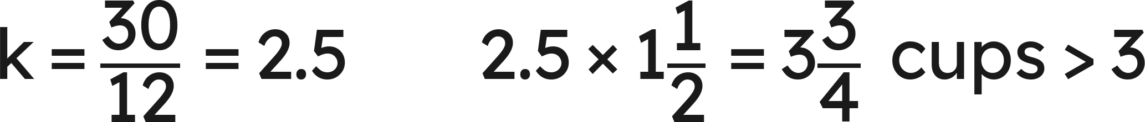
Notes
III. Scale a recipe, then check the pantry
Grade 7 Accelerated · Unit 5 · Lessons 10–11 — Multi-Step Proportion Problems
7

Slide 185
Example 1
.
Runner A does 5 mi in 40 min; runner B does 9 km in 45 min.
Find each speed in km/h. Who is faster?
Grade 7 Accelerated · Unit 5 · Lessons 10–11 — Multi-Step Proportion Problems
8

Slide 186
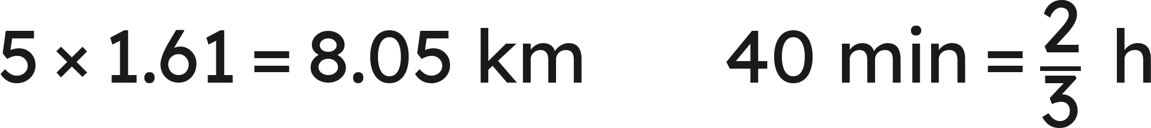
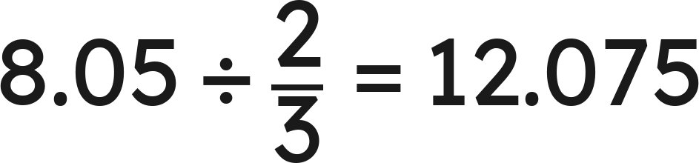
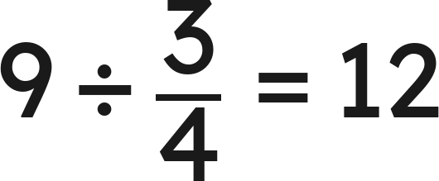

Example 1
Answer: A ≈ 12.08 km/h, B = 12 km/h: A
Grade 7 Accelerated · Unit 5 · Lessons 10–11 — Multi-Step Proportion Problems
9

Slide 187

Your Turn
.
Runner A does 4 mi in 30 min; runner B does 7 km in 35 min.
Find each speed in km/h. Who is faster?
Grade 7 Accelerated · Unit 5 · Lessons 10–11 — Multi-Step Proportion Problems
10

Slide 188

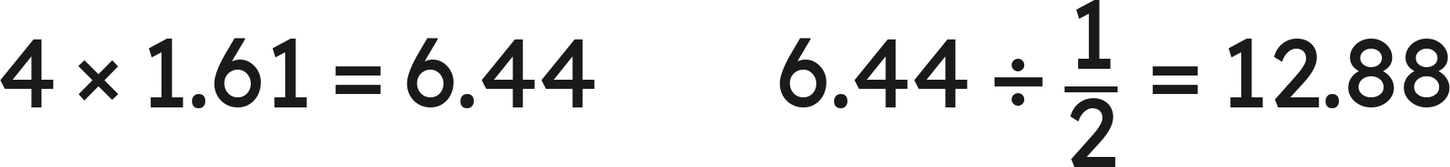

Your Turn
.
Runner A does 4 mi in 30 min; runner B does 7 km in 35 min.
Find each speed in km/h. Who is faster?
Answer: A = 12.88 km/h, B = 12 km/h: A
Grade 7 Accelerated · Unit 5 · Lessons 10–11 — Multi-Step Proportion Problems
11

Slide 189

Example 2
A recipe for 8 servings uses
cups of rice.
How much rice for 20 servings? With 5 cups on hand, how many servings can be made?
Grade 7 Accelerated · Unit 5 · Lessons 10–11 — Multi-Step Proportion Problems
12

Slide 190


Example 2
Answer: 6¼ cups; 16 servings
Grade 7 Accelerated · Unit 5 · Lessons 10–11 — Multi-Step Proportion Problems
13

Slide 191


Your Turn
A recipe for 6 servings uses
cups of rice.
How much rice for 12 servings?
With
cups on hand, how many servings?
Grade 7 Accelerated · Unit 5 · Lessons 10–11 — Multi-Step Proportion Problems
14

Slide 192




Your Turn
A recipe for 6 servings uses
cups of rice.
How much rice for 12 servings?
With
cups on hand, how many servings?
Answer: 3 cups; 18 servings
Grade 7 Accelerated · Unit 5 · Lessons 10–11 — Multi-Step Proportion Problems
15

Slide 193
Whiteboards · Question 1 of 9
A car gets 28 miles per gallon. Its tank holds 15 gal.
How far does it go on a full tank?
Answer it.
Grade 7 Accelerated · Unit 5 · Lessons 10–11 — Multi-Step Proportion Problems
16

Slide 194

Whiteboards · Question 1 of 9
A car gets 28 miles per gallon. Its tank holds 15 gal.
How far does it go on a full tank?
Answer: 420 mi
Grade 7 Accelerated · Unit 5 · Lessons 10–11 — Multi-Step Proportion Problems
17

Slide 195
Whiteboards · Question 2 of 9
A printer prints 35 pages per minute. A job is 1,400 pages.
How long does the job take?
Answer it.
Grade 7 Accelerated · Unit 5 · Lessons 10–11 — Multi-Step Proportion Problems
18

Slide 196

Whiteboards · Question 2 of 9
A printer prints 35 pages per minute. A job is 1,400 pages.
How long does the job take?
Answer: 40 min
Grade 7 Accelerated · Unit 5 · Lessons 10–11 — Multi-Step Proportion Problems
19

Slide 197
Whiteboards · Question 3 of 9
Mia earns $14.50 per hour at a shop 2 mi from home, 6 h a day for 5 days.
How much does she earn?
Answer it.
Grade 7 Accelerated · Unit 5 · Lessons 10–11 — Multi-Step Proportion Problems
20

Slide 198
Whiteboards · Question 3 of 9
Mia earns $14.50 per hour at a shop 2 mi from home, 6 h a day for 5 days.
How much does she earn?
Answer: $435
Grade 7 Accelerated · Unit 5 · Lessons 10–11 — Multi-Step Proportion Problems
21

Slide 199



Whiteboards · Question 4 of 9
A car gets 30 miles per gallon with a 12-gal tank. It makes a 900-mi trip.
How many tanks of gas does the trip use? (Part of a tank counts as a whole tank.)
A.
B.
C.
D.
Answer it.
Grade 7 Accelerated · Unit 5 · Lessons 10–11 — Multi-Step Proportion Problems
22

Slide 200
Whiteboards · Question 4 of 9
A car gets 30 miles per gallon with a 12-gal tank. It makes a 900-mi trip.
How many tanks of gas does the trip use? (Part of a tank counts as a whole tank.)
Answer: D — 3 tanks
Grade 7 Accelerated · Unit 5 · Lessons 10–11 — Multi-Step Proportion Problems
23

Slide 201
Whiteboards · Question 5 of 9
A cereal has 12 g of protein per 100 g.
How many grams of protein in 1 kg?
Answer it.
Grade 7 Accelerated · Unit 5 · Lessons 10–11 — Multi-Step Proportion Problems
24

Slide 202
Whiteboards · Question 5 of 9
A cereal has 12 g of protein per 100 g.
How many grams of protein in 1 kg?
Answer: 120 g
Grade 7 Accelerated · Unit 5 · Lessons 10–11 — Multi-Step Proportion Problems
25

Slide 203
Whiteboards · Question 6 of 9
.
Cyclist A rides 12 km in 50 min; cyclist B rides 7 mi in 45 min.
Who is faster?
A. Tie: 12 and 12
B. A: 12 > 7
C. B: 15.0 > 14.4
D. A: 14.4 > 11.27
Answer it.
Grade 7 Accelerated · Unit 5 · Lessons 10–11 — Multi-Step Proportion Problems
26

Slide 204


Whiteboards · Question 6 of 9
.
Cyclist A rides 12 km in 50 min; cyclist B rides 7 mi in 45 min.
Who is faster?
Answer: C — cyclist B
Grade 7 Accelerated · Unit 5 · Lessons 10–11 — Multi-Step Proportion Problems
27

Slide 205

Whiteboards · Question 7 of 9
Paint is mixed white : blue : grey =
.
A batch uses 8 gal of white.
How many gallons is the whole batch?
Answer it.
Grade 7 Accelerated · Unit 5 · Lessons 10–11 — Multi-Step Proportion Problems
28

Slide 206



Whiteboards · Question 7 of 9
Paint is mixed white : blue : grey =
.
A batch uses 8 gal of white.
How many gallons is the whole batch?
Answer: 44 gal
Grade 7 Accelerated · Unit 5 · Lessons 10–11 — Multi-Step Proportion Problems
29

Slide 207
Whiteboards · Question 8 of 9
A plan is drawn at
; a room is 2 in by 2.5 in on it.
.
Find the room's area in square meters.
Answer it.
Grade 7 Accelerated · Unit 5 · Lessons 10–11 — Multi-Step Proportion Problems
30

Slide 208

Whiteboards · Question 8 of 9
A plan is drawn at
; a room is 2 in by 2.5 in on it.
.
Find the room's area in square meters.
Answer: About 7.44 m²
Grade 7 Accelerated · Unit 5 · Lessons 10–11 — Multi-Step Proportion Problems
31

Slide 209
Whiteboards · Question 9 of 9
.
A 300-km drive.
Car A averages 50 mi/h; car B averages 75 km/h.
Which car gets there first, and by how long? Explain.
Write your answer in sentences.
Grade 7 Accelerated · Unit 5 · Lessons 10–11 — Multi-Step Proportion Problems
32

Slide 210
Whiteboards · Question 9 of 9
.
A 300-km drive.
Car A averages 50 mi/h; car B averages 75 km/h.
Which car gets there first, and by how long? Explain.
Answer: Car A: 80.5 km/h against 75, so about 3.73 h against 4 h — about 16 minutes sooner.
Grade 7 Accelerated · Unit 5 · Lessons 10–11 — Multi-Step Proportion Problems
33

Slide 211



Independent Set
1.
A car gets 32 miles per gallon and its tank holds 14 gal. How far does it go on a
tank?
2.
That car makes a 1,000-mi trip. How many tanks of gas does it use? (Part of a
tank counts as a whole tank.)
3.
A recipe for 4 servings uses
cups of rice. How much rice for 10 servings?
4.
. A train does 120 km/h; a bus does 70 mi/h. Which is faster? Show
the speeds in one unit.
5.
Juice is mixed orange : mango : water =
. A batch uses 9 cups of orange.
How many cups is the whole batch?
6.
A plan is drawn at
; a room is 2 in by 3.5 in on it. Find the room's real area.
Grade 7 Accelerated · Unit 5 · Lessons 10–11 — Multi-Step Proportion Problems
34

Slide 212
IXL
1.
Open IXL and start today's skills.
2.
Work on paper where the question needs work. The answer box does not show it.
3.
Every skill listed is required, to a SmartScore of 67. Due at the start of the next class.
Today's skills — all required
Compare rates: word problems — VVS
Multi-step problems with customary or metric unit conversions — UCT
Grade 7 Accelerated · Unit 5 · Lessons 10–11 — Multi-Step Proportion Problems
35

